Slide 1
Predicting Problematic Internet Use
Aaron Weinberg
Emilie Wiesner
Dan Visscher
Notes:
The goal of our project is to predict instances of problematic internet use in children. [click]

Slide 2
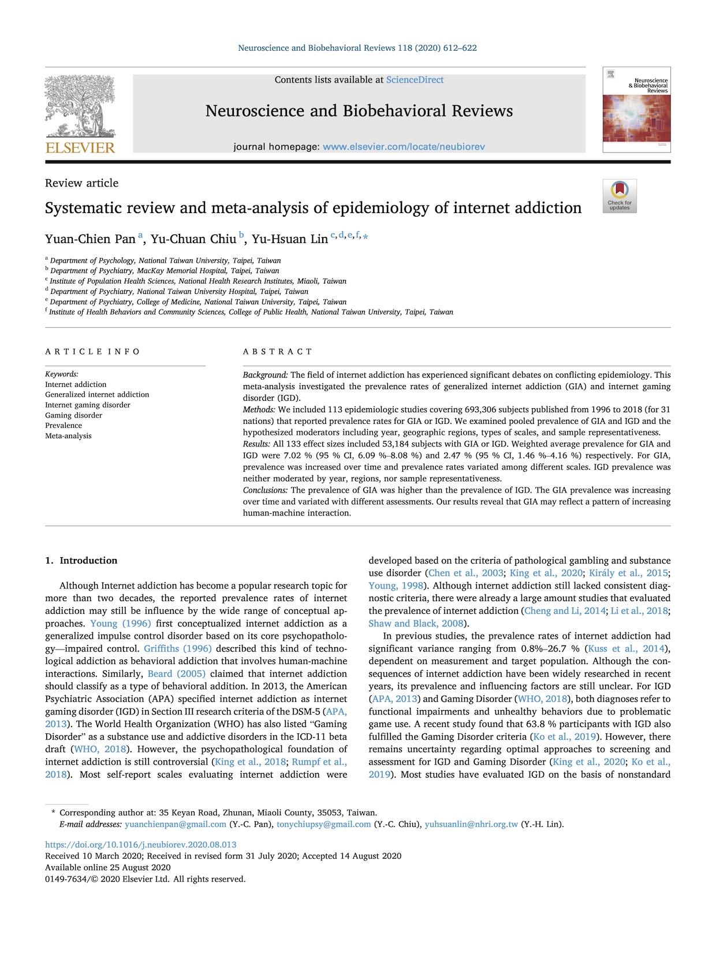


The Problem
Notes:
Researchers [click]
have identified internet use as having the potential to rise to the level of addiction, and [click]
problematic internet use is associated with increased rates of anxiety and depression. However, currently, identifying problematic internet usage requires complex, expert evaluation, which limits our ability to identify it [click]
In contrast [click]

Slide 3

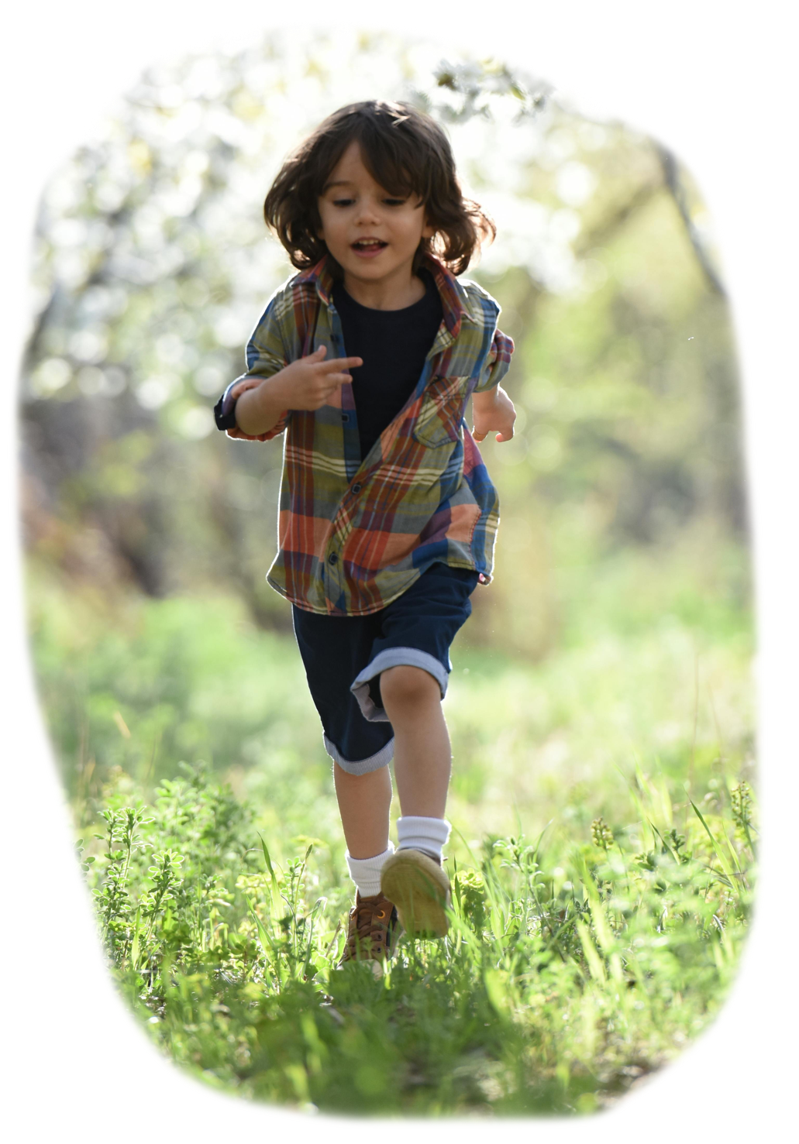

The Goal
Identify early signs of problematic internet use based on physical activity and fitness data.
Notes:
It is relatively straightforward to [click]
administer simple surveys and [click]
measure children’s activity level. Thus, the goal of our project is to [click]
Identify early signs of problematic internet use based on physical activity and fitness data. This project came to us by way of Kaggle, which is a data science competition platform. This particular research question [click]
was posed by the Child-Mind Institute, which supports children and families who are struggling with mental health [click]

Slide 4
5,000 children
Ages 5 through 22
No participants with complete data
HEALTHY BRAIN NETWORK
The Data
Notes:
The data for the competition comes from the Institute’s healthy brain network study. Participants in the study included [click] about five-thousand 5-22 year-olds, although we only had access to data from approximately 3500 of these participants. [click] and we had no participants with data for all of the provided predictors. [click]

Slide 5
Parent-Child Internet Addiction Test (PCIAT)
0
1
2
3
None
Severe
Severity Impairment Index (SII)
~3000 with at least some target information
Impute missing PCIAT scores
The Data: Target Variable
Notes:
The target variable is [click]
the severity impairment index, or sii. Participants completed [click]
A 20-question parent-child internet addiction test, or PCIAT. [click]
The total scores were binned into four levels, ranging from 0, or no impairment, to 3, or severe impairment. [click]
Of the 3960 participants for whom we had some data approximately 3,000 had reported scores for at least some of the PCIAT questions [click]
So we used KNN imputation to fill in missing PCIAT scores [click]

Slide 6

Demographics
Age
Sex
Physical
Height
Weight
BMI
Waist
Systolic BP
Diastolic BP
Heart Rate
The Data: Predictor Variables
Notes:
We were given a total of 33 predictor variable, spanning a variety of measurements. The variables naturally fall into several groupings. [click]
Basic demographics [click]
And basic physical measurements like height and weight. [click]

Slide 7
Demographics
Age
Sex
Internet Use
Hours per Day
Physical
Height
Weight
BMI
Waist
Systolic BP
Diastolic BP
Heart Rate
Children's Global Assessment Scale
Sleep Disturbance Scale
Physical Activity Questionnaire
PAQ MVPA Zone
The Data: Predictor Variables
Notes:
Then there was data from several surveys [click]
Including reported internet use [click]
A Children’s Global Assessment Scale [click]
A Sleep Disturbance Scale [click]
And a physical activity questionnaire. [click]
A review of the research suggested cutoffs we used to compute whether participants had reached a threshold of physical activity. [click]

Slide 8
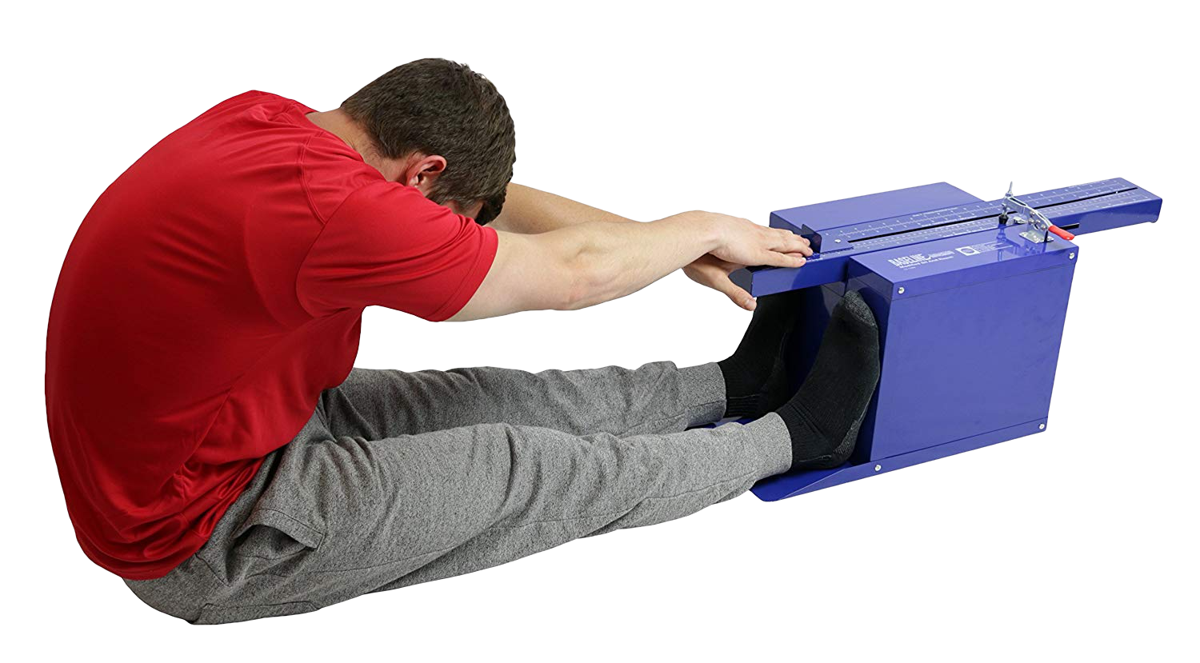
Demographics
Age
Sex
Internet Use
Hours per Day
Fitness
Endurance Time
Endurance Max
Curl-Up
Grip Strength D
Grip Strength ND
Push-Up
Sit & Reach Left
Sit & Reach Right
Trunk Lift
Physical
Height
Weight
BMI
Waist
Systolic BP
Diastolic BP
Heart Rate
Children's Global Assessment Scale
Sleep Disturbance Scale
Physical Activity Questionnaire
Fitness Zone
Curl-Up
Grip Strength D
Grip Strength ND
Push-Up
Sit & Reach Left
Sit & Reach Right
Trunk Lift
PAQ MVPA Zone
The Data: Predictor Variables
Notes:
There were results from a fitness test similar to the Presidential Fitness Test [click]
that some of you may have completed in grade school, [click]
We found reference values that allowed us to compute whether each of these measurements was in a target zone. [click]

Slide 9
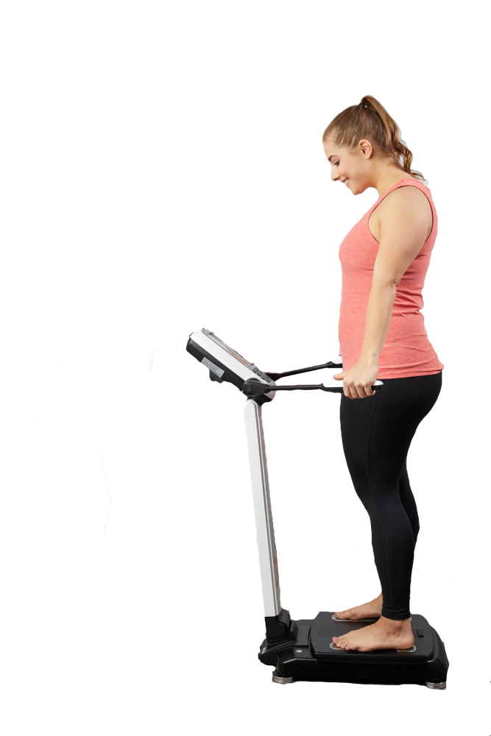
Demographics
Age
Sex
Internet Use
Hours per Day
Fitness
Endurance Time
Endurance Max
Curl-Up
Grip Strength D
Grip Strength ND
Push-Up
Sit & Reach Left
Sit & Reach Right
Trunk Lift
BIA
Bone Mineral Content
BMI
Basal Metabolic Rate
Daily Energy Exp.
Extracellular Water
Fat Free Mass
FFM Index
Fat Mass Index
Body Fat Percentage
Body Frame
Intracellular Water
Lean Dry Mass
Lean Soft Tissue
Skeletal Muscle Mass
Total Body Water
Physical
Height
Weight
BMI
Waist
Systolic BP
Diastolic BP
Heart Rate
Children's Global Assessment Scale
Sleep Disturbance Scale
Physical Activity Questionnaire
Fitness Zone
Curl-Up
Grip Strength D
Grip Strength ND
Push-Up
Sit & Reach Left
Sit & Reach Right
Trunk Lift
PAQ MVPA Zone
The Data: Predictor Variables
Notes:
Other predictors came from measurements of bio-electric impedance [click]
Including things like bone mineral content and total body water. [click]

Slide 10
Demographics
Age
Sex
Internet Use
Hours per Day
Fitness
Endurance Time
Endurance Max
Curl-Up
Grip Strength D
Grip Strength ND
Push-Up
Sit & Reach Left
Sit & Reach Right
Trunk Lift
BIA
Bone Mineral Content
BMI
Basal Metabolic Rate
Daily Energy Exp.
Extracellular Water
Fat Free Mass
FFM Index
Fat Mass Index
Body Fat Percentage
Body Frame
Intracellular Water
Lean Dry Mass
Lean Soft Tissue
Skeletal Muscle Mass
Total Body Water
Physical
Height
Weight
BMI
Waist
Systolic BP
Diastolic BP
Heart Rate
Children's Global Assessment Scale
Sleep Disturbance Scale
Physical Activity Questionnaire
Fitness Zone
Curl-Up
Grip Strength D
Grip Strength ND
Push-Up
Sit & Reach Left
Sit & Reach Right
Trunk Lift
PAQ MVPA Zone
The Data: Predictor Variables
Notes:
For each variable we reviewed references in the literature to identify and eliminate outliers and problematic values [click]

Slide 11
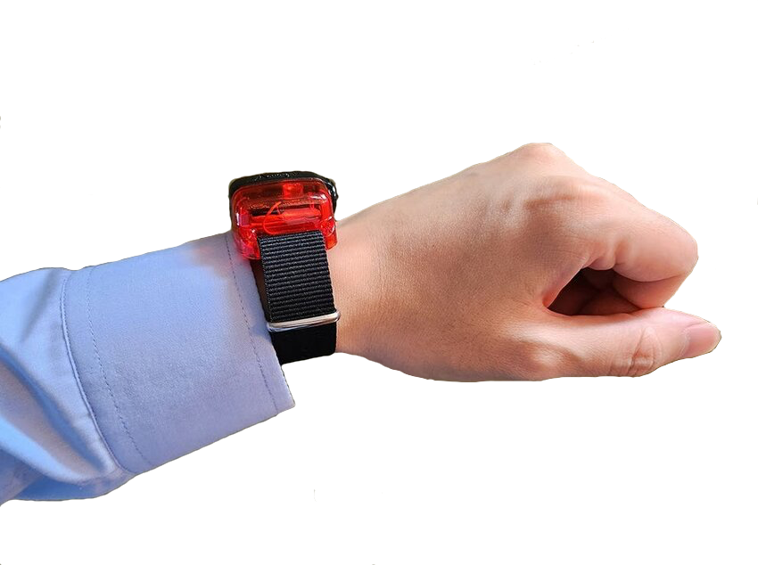
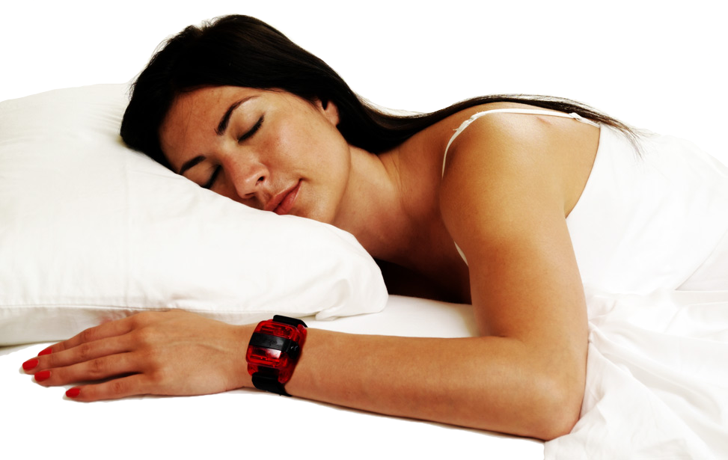


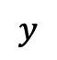

Continuous recording of accelerometer data for a single subject spanning many days.
$$z$$
$$x$$
$$θ$$
$$y$$
ENMO
5-minute bouts
The Data: Actigraphy
Thresholds
Notes:
Approximately 1000 participants were given a wrist-worn accelerometer [click]
Which reported acceleration in three dimensions [click]
And angle from horizontal. [click]
Unfortunately, some devices were set to record during sedentary activity and identify when they weren’t being worn, while others were set to just shut off during sedentary activity, [click]
so we had to design our methods to account for these instances [click]
We computed Euclidean Norm Minus One values [click]
Then grouped the data into 5-minute bouts to compute means [click]
We reviewed actigraphy research to identify thresholds and then computed daily rates above the thresholds for each participant. [click]

Slide 12
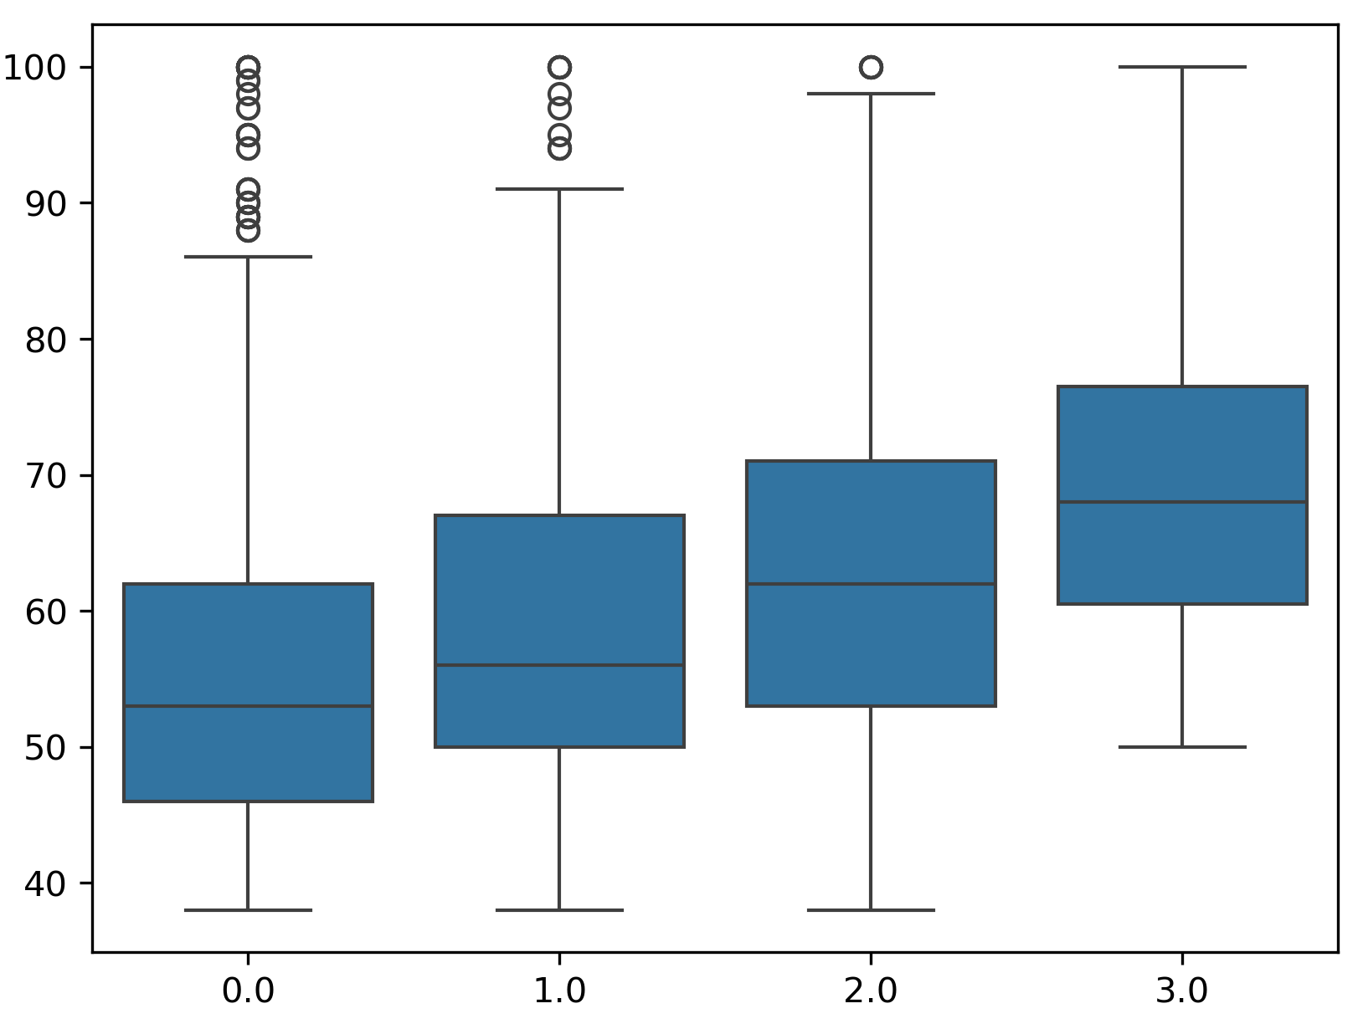
Missing data
Little predictive power
Predictor Variable
Outcome (SII)
Data Challenges
Notes:
In addition to the challenges of missing data described previously, we faced some important challenges intrinsic to the data itself. [click]
For each potential predictor variable we looked at [click]
When we compared values between levels of the outcome variable [click]
There was a considerable amount of variation and [click]
None of our variables demonstrated much predictive power [click]

Slide 13
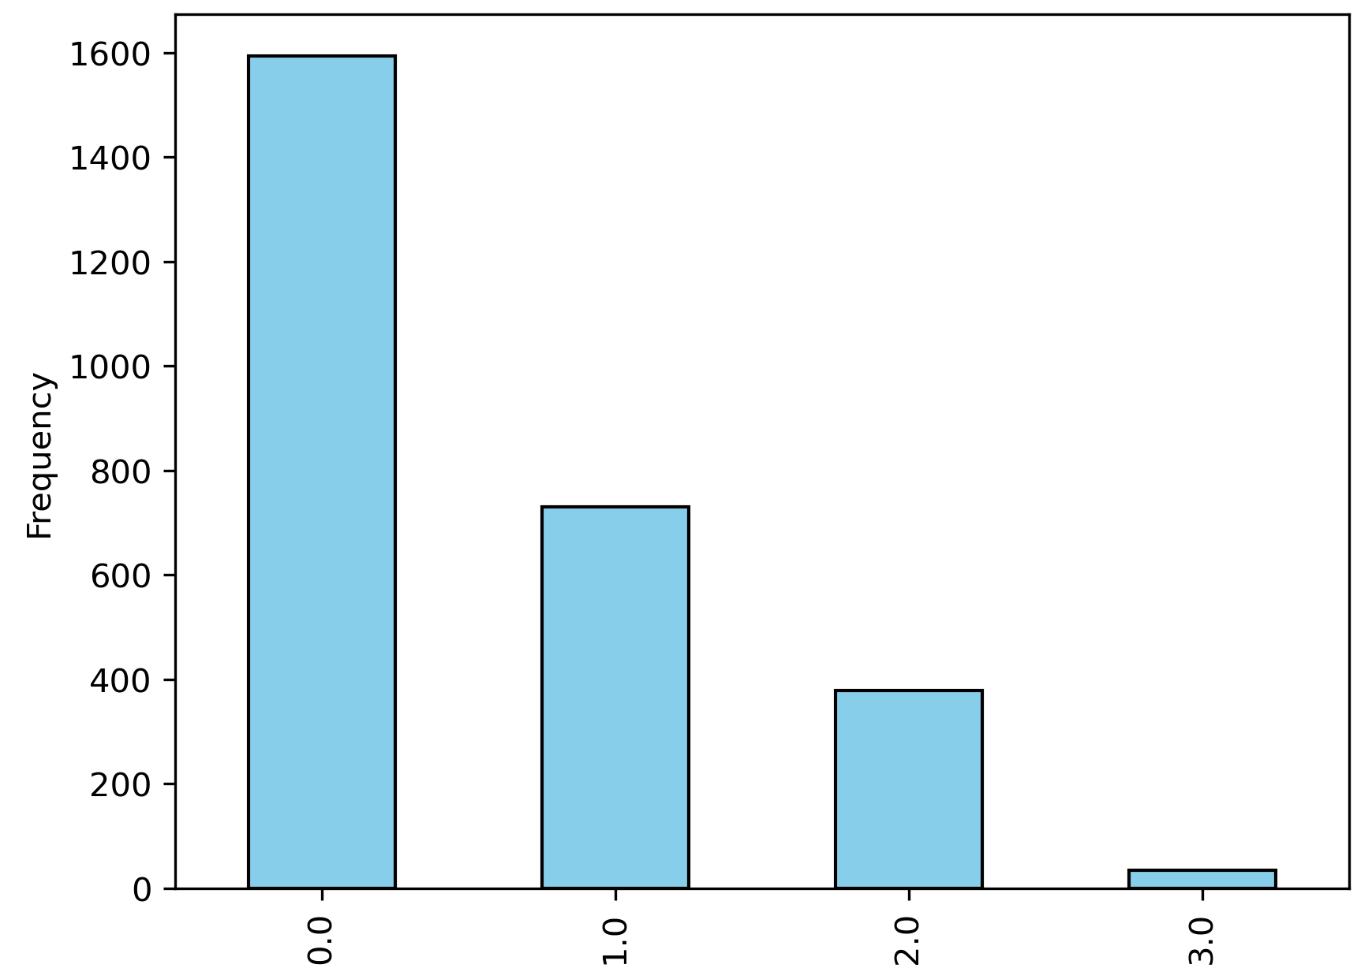
Missing data
Little predictive power
Sparse data for SII score 3.
Outcome (SII)
Data Challenges
Notes:
In addition, when we looked at [click]
the distribution of the values of our outcome variable, we found that there were only 32 participants who were measured with an SII score of 3; and a very high rate of 0’s. [click]
This sparse data meant that our models generally had a very hard time predicting higher levels of internet use [click]

Slide 14
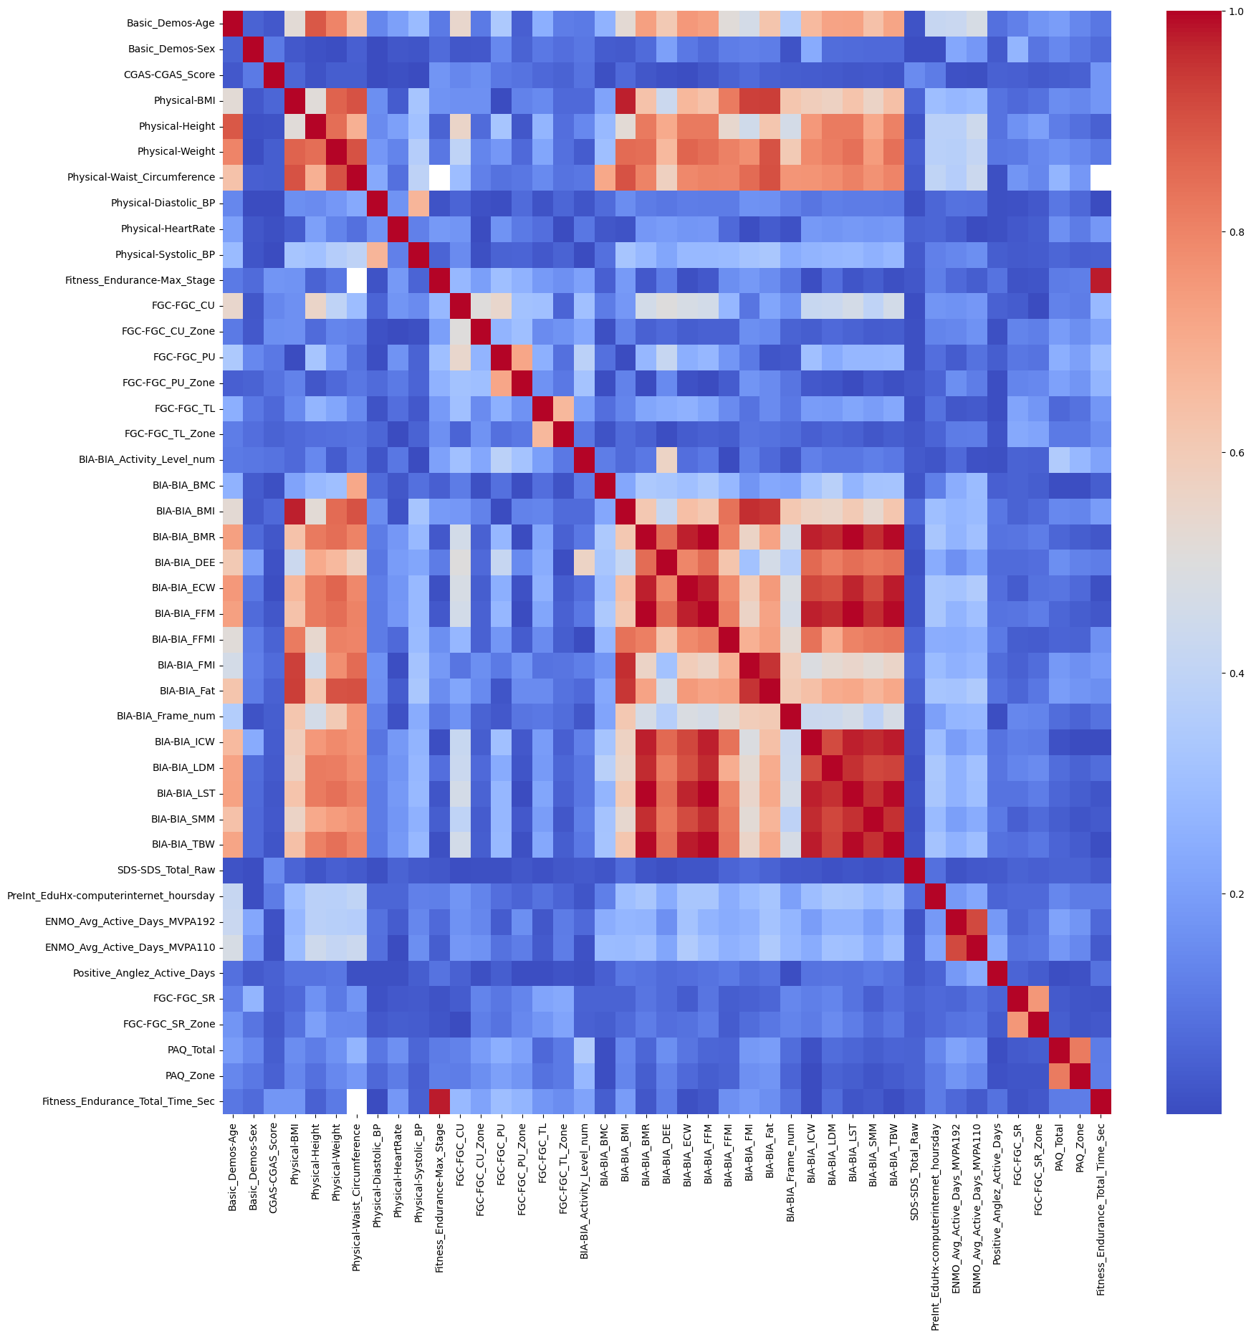
Missing data
Little predictive power
Sparse data for SII score 3.
Feature Reduction
Feature Selection
Data Challenges
Notes:
We also found that [click]
Many of our predictors were highly correlated And others were systematically missing [click]
So we engaged in several rounds of feature reduction [click]
And also identified important features using a random forest [click]

Slide 15
Cleaned, Computed, Outcome-Imputed, Feature-Selected Data
Custom Iterative Imputer
Custom Function Transformer
Sequential Ordinal Classifier Wrapper
Impute Predictors
Compute Predictors
SMOTE
sii=3
Fit & Predict
Kappa
SLR
MLR
Logistic
Random Forest SVR
AdaBoost
GradientBoost
XGBoost
+ Tuning
Modeling Process
Notes:
We began our modeling process [click]
With our cleaned, computed, outcome-imputed, and feature-selected data [click]
We designed an iterative imputer for missing predictor values [click]
A function transformer to compute zones for various predictors [click]
And a wrapper based on an algorithm to sequentially apply classifiers to ordinal data [click]
In our pipe [click]
We first imputed and computed predictors [click]
Then we oversampled the sii=3 class using a Synthetic Minority Oversampling Technique [click]
Then made our predictions [click]
Using Cohen’s kappa as our measure of accuracy. [click]
We tested out-of-the-box performance with a range of models [click]
Then tuned the most promising models

Slide 16
Modeling Process
Contest-specified evaluation: Cohen’s Kappa with quadratic weights
Measure of accuracy for ordinal variables
Imputation of missing values
KNN imputation of missing PCIAT question responses, for improved PCIAT total score/SII score.
Custom imputation for predictor variables:
Performance comparison of KNN vs. MICE
follow-up encoding of derived “zone” variables.
Duplicate data to inflate # of SII 3’s.
Multiple options for prediction
Predict SII directly, as quantitative variable
Predict PCIAT and compute SII
Option to tweak SII bin cut-offs.
Ordinal classifier for SII
Notes:
Some of these issues we attempted to address prior to modeling and some as part of the modeling process. Here we wanted to share some of the interesting aspects of our modeling work.
(CLICK) The competition evaluates submissions using Cohen’s Kappa, (CLICK) which is a measure of accuracy for ordinal variables. We couldn’t directly incorporate this into our model training as the loss function, but we did use this to compare models.
(CLICK) Because there was so much missing data, we needed to use imputation, rather than just remove cases with missing values.
(CLICK) Recall that the PCIAT questionnaire is the basis for the SII score, our ultimate target variable. We eliminated all cases that had no PCIAT data, and then imputed any remaining missing data for individual PCIAT questions. All questions were scored on the same scale, so we used KNN imputation here.
(CLICK) For the predictor variables, we tested both KNN and a MICE imputation. Some of the variables, various fitness zones, were derived from the fitness test quantitative measurements. Rather than imputing the zone values, we computed these separately after running the imputation.
(CLICK) To address the low number of severe, or 3 values, for the target variable SII, we also tested models where we duplicated cases with SII scores of 3 in our training data, and we ultimately found that this increased the effectiveness of our models.
(CLICK) Lastly, we had a choice of exactly what we would use as our target variable. Recall that SII is an ordinal variable, derived from the PCIAT score, a quantitative variable. (CLICK) One option would be to predict SII directly, treating it as essentially a quantitative variable. (CLICK) Another option was to predict PCIAT scores and then compute SII based on it. In this scenario, we found that our models seemed to underpredict SII. In fact, we could not build a model that would predict any 3’s, the highest SII score. To try to address this, we also played with different cut points for translating PCIAT score to SII. (CLICK) The last option we saw was to try to predict SII using classification. However, we didn’t want to lose the fact that SII is an ordinal variable. So rather than using straight classification, we identified some strategies for an ordinal classifier.

Slide 17
Final Results
Say something here about the models that rose to the top and the performance of those models.

